Slide 1
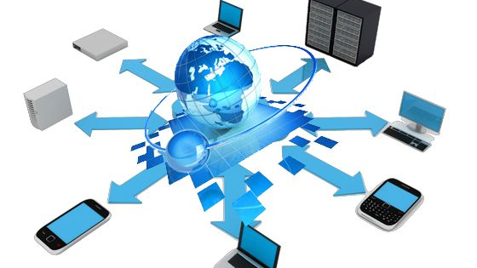
WAN BASICS

Slide 2

Introduction to WAN
Our own networks are called LANs (Local Area Network). We own and operate these networks. It’s called a “local” area network since all devices that make up the LAN are close to each other. Perhaps in one building or a few buildings close to each other (called a campus).
When we need access to other remote networks, connect two LANs together or give others access to our LAN, we need a WAN (Wide Area Network). As the name implies, WANs cover large geographical areas. This could be a network between two cities or as large as the Internet.
WANs are operated by companies like phone/cable companies, service providers, or satellite companies. They build large networks that span entire cities or regions and lease the right to use their networks to their customers.

Slide 3
WAN Technologies
There are a number of different methods how we can forward data on a network:
Circuit switching
Packet switching
Cell switching

Slide 4
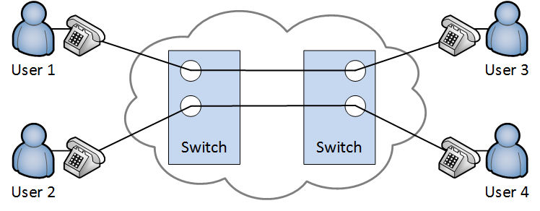
Circuit switching
To understand circuit switching, it’s best to look at how telephony worked back in the 60s
The phone network used telephone switchboards that were operated by switchboard operators who connected calls by plugging in phone plugs in the required phone jacks. To connect long-distance calls, operators had to work together with operators in other offices.
Once the correct plugs were connected, a circuit was established between two callers which allowed them to talk to each other.
Later, the operators were replaced by electromechanical automatic telephone exchanges but circuit switching was still used to establish analog phone calls on our PSTN (Public Switched Telephone Network) which is also known as POTS (Post Office Telephone Service or Plain Old Telephone System).
ISDN (Integrated Services Digital Network) also used circuit switching and supported data rates of 64 kbps per data channel.
The problem with circuit switching is the limited capacity that it offers. Once the circuit is established, you make a reservation in the network and you end up with a fixed capacity for the circuit. It doesn’t matter how much data you transmit or not, the circuit will be there for you. This also means that you waste a lot of unused resources…

Slide 5
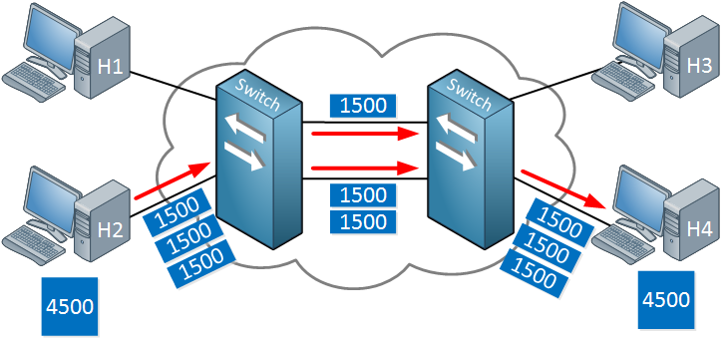
Packet Switching
The idea behind it is that we break our data down in “chunks”. Each chunk is a packet that is sent on the network. This is what we mostly use on our networks nowadays. The packet size is variable, there is no fixed size.
Packet switching has mostly replaced circuit switching. One of the advantages is that because there are no fixed circuits, we can more effectively use the capacity that the network has to offer. We don’t waste any unused resources.
To the left you can see that host 2 wants to send 4500 bytes of data. This is broken down in 3x 1500 byte packets. One packet is sent on the top link, the other two on the bottom link. With packet switching, there’s no fixed path in the network. Once host 4 receives all packets, it can extract and reassemble the data.

Slide 6
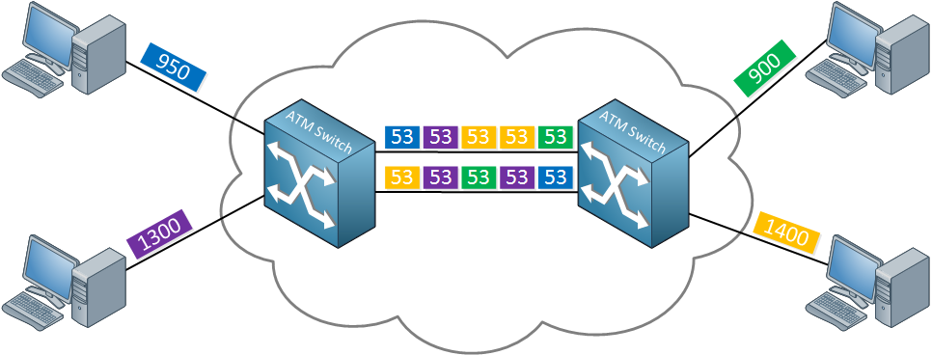
Cell switching
Cell switching is very similar to packet switching with the exception that we use a fixed for our size for our cells.
you can see that each computer sends some data. Whatever they send gets encapsulated in cells with a fixed size, 53 bytes in my example. ATM (Asynchronous Transfer Mode) was a popular WAN protocol that used cell switching.

Slide 7
WAN Technologies Cont.
Leased Lines
Leased lines are one of the older WAN options. Imagine we have a LAN in New York and another LAN in Miami. Somehow, we need to connect these two networks. A leased line is a point-to-point link that we exclusively use, often offered by a phone company.
Frame-relay
Frame-relay is also an older WAN technology that was an alternative to leased lines. With a leased line, you are the only one using the link so it’s quite an expensive option. Frame-relay offers point-to-point and point-to-multipoint circuits with a shared network, which is cheaper than a dedicated line.
DSL
DSL (Digital Subscriber Line) became a very popular option for high-speed Internet access since it uses the analog phone cables that pretty much every home or building has. The speed that you get depends on the distance between your home and the phone company.
At the customer, we have a splitter that is connected to the phone line that the phone company offers. One RJ11 (phone cable) goes to your analog phones, the other one is connected to a DSL modem. The DSL modem has an Ethernet connection to your router. Nowadays, the DSL modem is often integrated in the router.
The phone company uses a device called a DSLAM (DSL access multiplexer) which splits the data traffic and voice traffic from each other. Data traffic is forwarded to a router, voice traffic to a voice switch.

Slide 8
WAN Technologies Cont.
Cable
Cable Internet is similar to DSL, it also became popular since most homes and buildings have a cable connection. Cable Internet uses the DOCSIS (Data Over Cable Service Interface Specification) standard to transport data over a coaxial cable.
Coaxial cables offer a wider frequency range than the two pair phone cables we use for DSL, allowing higher throughput. Some cable providers offer ~ 300 Mbit connections.
Cable internet often offers higher bandwidth but this can depend on the number of subscribers on the network.
Ethernet
Ethernet has also made its way to the WAN. The 1000BASE-ZX standard, for example, supports a distance of ~40 miles over single-mode fiber connections.
On each customer site, we have a router with a fiber connection to the Ethernet WAN provider. The connection at the service provider side is called the POP (Point of Presence). Many providers call this an Ethernet private line. It’s also possible to have more than two sites, creating a multi-access network.

Slide 9

QUESTIONS

Slide 10
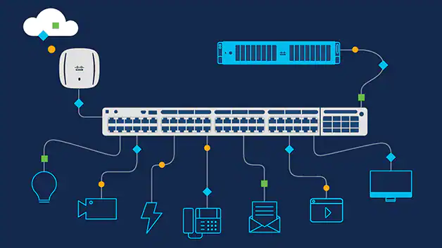
LAN BASICS

Slide 11

Internetwork Design Fundamentals
While understanding the different network technologies and protocols is a core requirement of a network engineer, you are also expected to understand how to plan for network implementation and perform the actual implementation, in addition to verification of the network and troubleshooting.

Slide 12
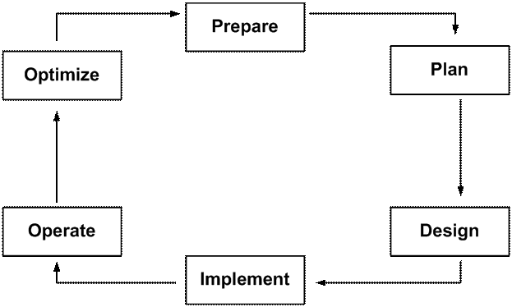
The Cisco PPDIOO Life-Cycle Approach

Slide 13
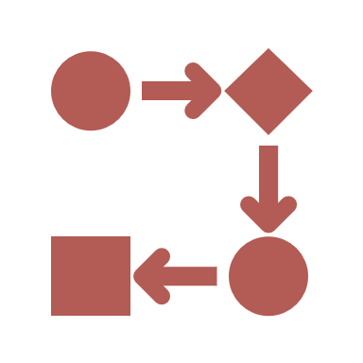
PPDIOO
Stands for Prepare, Plan, Design, Implement, Operate, and Optimize.
The PPDIOO life-cycle approach is a network service’s life-cycle framework to help ensure that when the project is implemented the entire company will have everything it needs to operate and maintain the new network.

Slide 14
PREPARE
During the prepare phase, key decision-makers identify the initial requirements.
Tasks that are completed during this phase include gathering organizational requirements, network strategy, and business case strategy.
After the business requirements have been captured, a high-level conceptual architecture is proposed.

Slide 15
PLAN
The plan phase is used to understand the business requirements and to provide an accurate assessment of a company’s current network, security state, and overall readiness to support the proposed solution.
The plan phase includes gathering network requirements, a full network examination, and a gap analysis.
During this phase, design engineers verify the requirements, conduct workshops, and complete site surveys. The objective of this phase is to determine whether the company has adequate resources to manage a technology deployment project to completion
This phase is then concluded by developing a detailed project plan to identify resources, potential difficulties, individual responsibilities, and critical tasks necessary to deliver the final project on time and on budget.
Considerations at this stage include carefully examining single points of failure, characterizing application and protocol traffic, and analyzing bandwidth availability.

Slide 16
DESIGN
The objective of the design phase is a comprehensive, detailed (low-level) design.
A solid design can improve network performance and support high availability, reliability, security, and scalability.
Proof of concept, which includes building pilots or prototypes, is also included in this phase to ensure that the design meets business and technical requirements.
The design phase can also guide and accelerate successful implementation with a plan to stage, configure, test, and validate network operations.

Slide 17
IMPLEMENT
The implementation phase is the phase that you, as a CCNP-level network engineer, will tie into the PPDIOO life-cycle approach.
This phase includes the creation of a detailed implementation plan, which is then followed by the actual implementation itself.
The implementation is based on design specifications, with the objective being to integrate devices without disrupting the existing network or creating points of vulnerability.

Slide 18
OPERATE
The operate phase includes the day-to-day operation of the network.
The objective of this phase is to improve service quality; reduce disruptions; mitigate outages; and maintain high availability, reliability, and security.

Slide 19
OPTIMIZE
The optimize phase includes working with operations in order to establish and identify system improvements.
This is based on proactive network monitoring, and, in some cases, reactive fault detection and correction.
This phase seeks to improve network performance, expand services, and incorporate period reassessments of the network, which may result in a redesign if the current network is experiencing too many faults or does not meet performance expectations. The ultimate objective is continually evolving the network and improving results.

Slide 20

A good, solid implementation plan should include the following items:
A checklist of tasks that need to be completed
A list of tools and resources needed
The schedule of work, coordinated with all needed resources
The actual device configurations
Documented verification processes and tests
A fallback or back-out plan
It is important to create a checklist of the tasks that need to be completed and to check off each one following completion. This ensures that all tasks are completed and have been verified correctly. If you do not create a checklist, you may miss one or two steps, which may result in an unsuccessful implementation or unnecessary troubleshooting during the implementation.

Slide 21

QUESTIONS

Slide 22
IIN
The Intelligent Information Network (IIN) is a Cisco ideal wherein network and application services are integrated, allowing for cost savings and improved user productivity. The IIN is broken up into the following three individual phases:
Integrated Systems (Integrated Transport)
Integrated Services
Integrated Applications (AON)

Slide 23
Phase 1 of the IIN is the Integrated Systems (also referred to as Integrated Transport) phase. This phase involves the convergence of voice, data, and video into a single transport network or across a system of networks. This phase is facilitated by platforms such as Cisco ISR routers.
Phase 2 of the IIN is the Integrated Services phase. This phase merges common elements such as storage and data center server capacity. Additionally, virtualization technologies allow for the integration of servers, storage, and network devices.
Phase 3 of the IIN is the Integrated Applications phase. This phase is the ultimate goal of the IIN in that it allows the network to become application-aware. Cisco refers to this as Application-Oriented Networking (AON).

Slide 24
SONA
The Cisco Service-Oriented Network Architecture (SONA) framework applies Intelligent Information Network (IIN) within the enterprise network. SONA divides the IIN ideal into the following three different layers:
The Network Infrastructure Layer
The Interactive Services Layer
The Application Layer

Slide 25
The network infrastructure layer, also referred to as the physical infrastructure layer, facilitates the transport of services across the network. It refers to a hierarchical converged network that includes servers, storage, and clients.
The interactive services layer, also referred to as the core common services layer, optimizes the communication between applications and services using intelligent network functions such as security, identity, voice, virtualization, and quality of service.
The application layer contains the business and collaboration applications used by end users. These applications include commercial and internally developed applications, Software-as-a-Service (SaaS), and composite applications within the Service-Oriented Architecture (SOA).

Slide 26
The Hierarchical Design Model
The hierarchical model follows the same basic concept as the OSI Reference Model, which is layering.
Each layer is responsible for a particular function, or sets of functions, a layered approach simplifies the tasks required for hosts to communicate, as well as other basic networking tasks such as troubleshooting connectivity issues between the hosts.
The LAN hierarchical model is no different.

Slide 27
The LAN hierarchical model is comprised of the following three layers:
The Core Layer
The Distribution Layer
The Access Layer

Slide 28
CORE LAYER
The core layer provides optimal transport between sites.
It is a high-speed switching backbone and should be designed to switch packets as fast as possible.
This layer of the network should not perform any packet manipulation, such as access lists and filtering, that would slow down the switching of packets.

Slide 29
DISTRIBUTION LAYER
The distribution layer is where packet manipulation takes place.
It provides boundary definition and is the demarcation point between the access and core layers.
The distribution layer can include several functions, as follows:
Address or area aggregation
Departmental or workgroup access
VLAN routing
Broadcast or Multicast domain definition
Media transitions
Security

Slide 30
ACCESS LAYER
The access layer provides workgroup or user access to the LAN.
In other words, the access layer is the point at which local users physically connect to the network.
The access layer may also use access lists or filters, such as MAC address filters, to optimize the needs of a particular set of users or to provide security.
Access layer functions can include the following:
Shared bandwidth (i.e., via hub connectivity)
Switched bandwidth (i.e., using LAN switches)
MAC layer and MAC address filtering

Slide 31
QUESTIONS

Slide 32
The Enterprise Network Composite Model
The Cisco Enterprise Composite Model (ECM) or Enterprise Composite Network Model (ECNM) provides a detailed design for the enterprise campus network and a converged, intelligent infrastructure to access IT resources across enterprise locations.
This model expands on the traditional hierarchical concepts of core, distribution, and access layers.
The enterprise network comprises two functional areas, which are the Enterprise campus and the Enterprise edge.

Slide 33
The Enterprise Campus is comprised of the following modules:
The Switch Module
The Core Module
The Management Module
The Server Module
The Enterprise Edge Distribution Module

Slide 34
SWITCH MODULE
The switch module is defined as the portion of the network that contains end-user workstations, phones, and their associated Layer 2 access points.
This module is comprised of access layer switches as well as their related distribution layer switches.
Its primary goal is to provide services to end users.

Slide 35
CORE MODULE
The core module is the portion of the network that routes and switches traffic as fast as possible from one network to another.
This is simply the core layer in the hierarchical network model.

Slide 36
MANAGEMENT MODULE
The management module allows for the secure management of all devices and hosts within the enterprise.
Within this module, logging and reporting information flows from the devices to the management hosts, while content, configurations, and new software flows to the devices from the management hosts.

Slide 37
SERVER MODULE
The server module provides application services to end users and devices.
Traffic flows on the server module are inspected by on-board intrusion detection within the Layer 3 switches.

Slide 38
QUESTIONS

Slide 39
The Enterprise Edge distribution module is comprised of the following modules:
The Corporate Internet Module
The VPN and Remote Access Module
The WAN Module
The E-Commerce Module

Slide 40
Corporate Internet Module
The corporate Internet module provides internal users with connectivity to Internet services.
It also provides Internet users access to information on the corporate public servers, such as public-facing E-Mail servers, for example.
To protect these servers, security devices such as Intrusion Detection Systems (IDS) or Intrusion Prevention Systems (IPS), as well as firewalls, typically are integrated into the design of this module.

Slide 41
VPN and Remote Access Module
The VPN and remote access block is responsible for terminating VPN traffic from remote users, providing a hub for terminating VPN traffic from remote sites, and terminating traffic from dial-in users.
All traffic forwarded to the enterprise edge distribution module is from remote corporate users that are authenticated in some fashion before being allowed through the firewall.

Slide 42
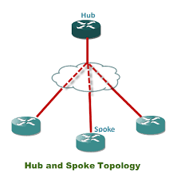
WAN Module
The WAN module is used for network connectivity between the central (hub) site and remote (spoke) sites.
E-Commerce Module
The E-Commerce module, which is used for E-Commerce, interfaces with the enterprise edge distribution module and the service provider edge module.

Slide 43
Campus Switched LAN Topologies
Three types of topologies can be used in campus switched LAN design, as listed and described below:
Scaled Switching
Large Switching with Minimal Routing
Distributed Routing and Switching

Slide 44
Scaled Switching
In a scaled switching LAN design, the entire LAN is comprised of only switches at all layers.
No routers are used or integrated into the LAN.
This design requires no knowledge of the addressing structure (since it is essentially a flat network), is low cost (from a monetary or financial point of view), and is very easy to manage.

Slide 45
Large Switching with Minimal Routing
The large switching with minimal routing design deploys switching at the access, distribution, and core layers.
At the distribution layer, routers are used to allow for inter-VLAN communication.
In this topology, routing is used only in the distribution layer, and the access layer depends on bandwidth through the distribution layer in order to gain access to high-speed switching functionality in the core layer.

Slide 46
Distributed Routing and Switching
The distributed routing and switching design follows the LAN hierarchical network model both physically and logically, which allows this design to scale very well.
This design is optimized for networks that adhere to the 20/80 rule, which is the majority of modern-day client-server networks.
This is the most common campus LAN design model in modern-day networks.

Slide 47
QUESTIONS

